Slide 1
SENTIMENT ANALYSIS
ISTE 612
BY
ANSHU RAINA
RAVITEJA GUNDA
SNEHA CHITTURI

Slide 2
CONTENTS
Introduction
Project Goal
Key Issues & Alternative ways
Related Work
System Design
Tools and Technologies
Data Exploration
Algorithm
Evaluation
Conclusion
Future Work

Slide 3
INTRODUCTION
Natural calamities / events
Public reaction
Public sentiment analysis
Useful for public / media / authorities

Slide 4
PROJECT GOAL
To analyze tweets collected from twitter(social networking site) and know what sentiment they represent and why ?

Slide 5
Key Issues & Alternative ways
Missing Values - Geo locations , Based on Location manually get the geo locations.
Tweets in different language , Use of translators.
Large data-Memory issue, amazon cloud to handle.
String concatenation-Low performance , string buffers instead.

Slide 6
Related Work
Applications like http://searchhash.com already exists which only retrieves tweets based on hash tag and doesn’t provide analysis on the tweets.
“Twitter Data analytics for Movie Reviews” provides analysis and reviews on newly released movies.
https://semantria.com application analyzes sentiment of tweets and Facebook posts.

Slide 7

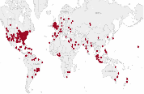
System Design
Twitter API
MongoDB
Classifier (NB)
Classified Instances
Tableau
Extracted Required Information
Report

Slide 8
Tools and Technologies used
NodeJs, Javascript for data collection
Java : JGrasp
Database : MongoDB
BI Tool : Tableau 8.1

Slide 9
DATA EXPLORATION
Data Collection:
1. Train data for weather analysis ( Kaggle website)
[size= 59885 instances]
2. Train data for sentimental analysis (Michigan data set) [size = 7096 instances]
3. Test data ( Twitter, Sandy Storm tweets).
[size= 43800 instances]
Data Characteristics:
Train Data contains 3 class labels of sentiment(positive, negative, neutral) and 15 class labels of weather.

Slide 10
Train Data Characteristics
Sentiment Class
S1 = Negative (size= 19807, tokens=259155)
S2 = Positive (size= 19907, tokens=258381)
S3 = Neutral (size= 20171, tokens=280796)
Weather Class
K7 = I cant tell (s= 14255, t=183884) K14 = tornado(s= 845, t=13651) K15 = Wind (s= 1955, t=26784)
K6 = Hurricane (s= 48, t= 774) K13 = Sun(s= 6719, t=93751)
K5 = Humid (s= 1971, t=26125) K12 = Storm (s= 7213, t=101019)
K4 = Hot (s= 6083, t=81042) K11 = Snow(s= 1293, t=18521)
K3 = Dry (s= 154, t=2627) K10 = Rain (s= 4925, t=73642)
K2 = Cold (s= 4888, t=64043) K9 = Other (s= 1550, t=22369)
K1 = Clouds (s= 863, t=13471) K8 = Ice (s=37, t=586)

Slide 11
Example Tweets
Theres nothing better than listening to mention on an early sunny Monday morning Have a great one
Another day full of sunshine promise here in St Louis Take time to smell the roses as walk through this world today
So Between flooding and storm damage etc anyone have any tipstools on how to navigate a road trip through LAMS Going from SC to TX
How the hell can weather change like that
Stormy weather ahead check your home Insurance
We are expecting a massive storm system tonight as is most of the country so mention

Slide 12
Classification Technique
Used Naïve Bayes Classifier
Training data is collected from Kaggle
Checked the uniformity of class counts (no of tweet/class)
Model built using the training data
Supplied test data taken from twitter to the model to predict the class labels

Slide 13
Classification Technique contd..
STEP #1
STEP #3
Training data set
Kaggle
Classifier NB1
Sentimental Analysis
Classifier NB2
Weather Analysis
Sentiments
Weather
Combined Result
Test Data
Model 1
Model 2
STEP #2
Analysis using Tableau

Slide 14
EVALUATION RESULTS
No of tweets containing hurricane, storms and snow = 9076
Total no of tweets = 11226
Accuracy = No of tweets (hurricane/storms/snow)
Total no of tweets
= 9076/11226
= 80.84%

Slide 15
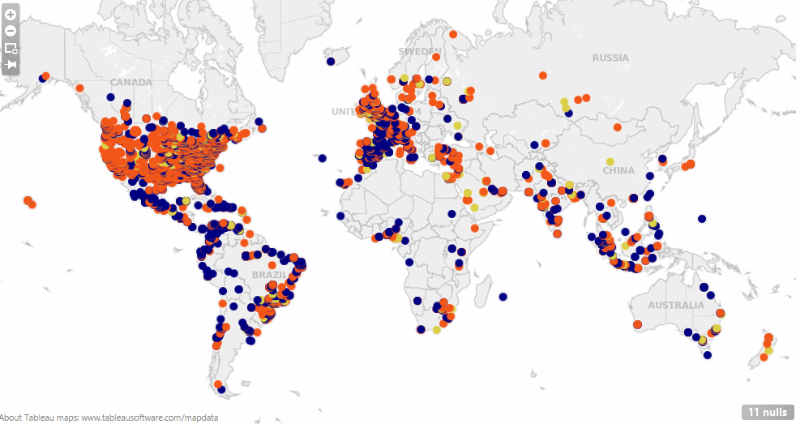
Sentiments for “Sandy” across globe

Slide 16
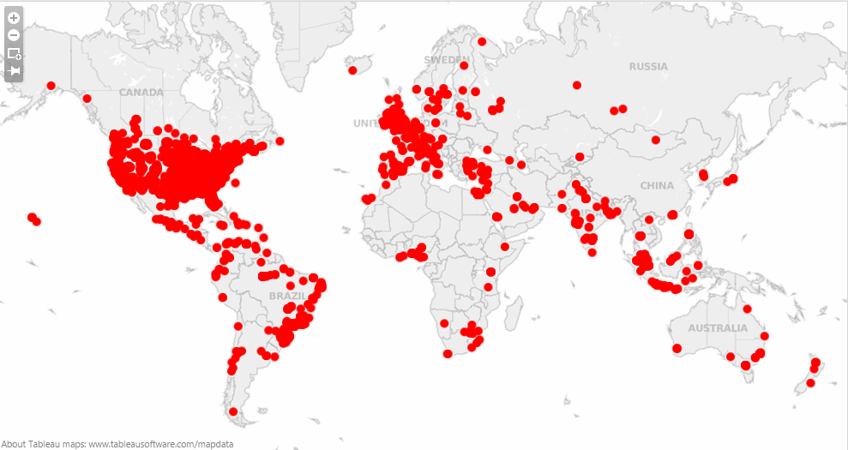
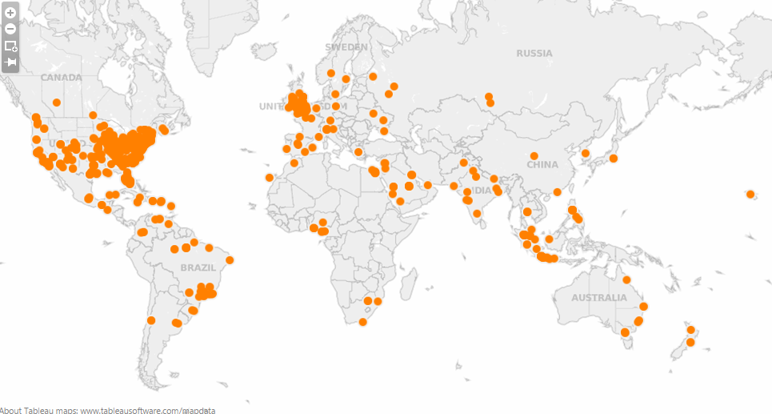
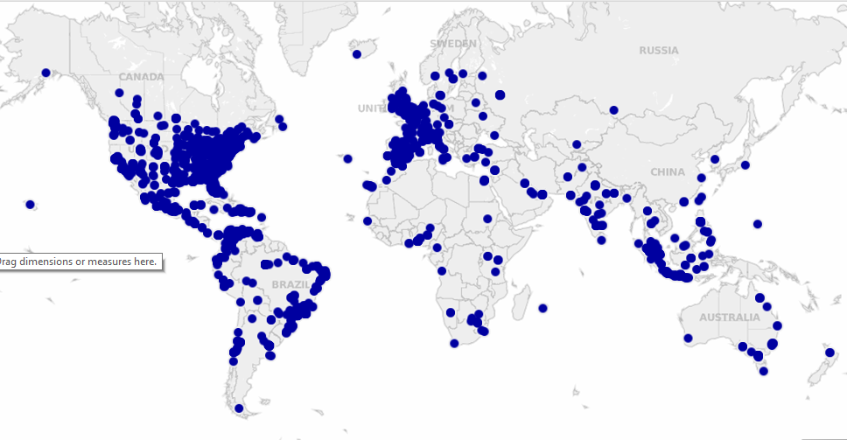
Sentiment-0 (Negative) , Sentiment-1 (Positive) & Sentiment-2 (Neutral)showing through out globe against “ Sandy “
Negative
Positive
Neutral

Slide 17
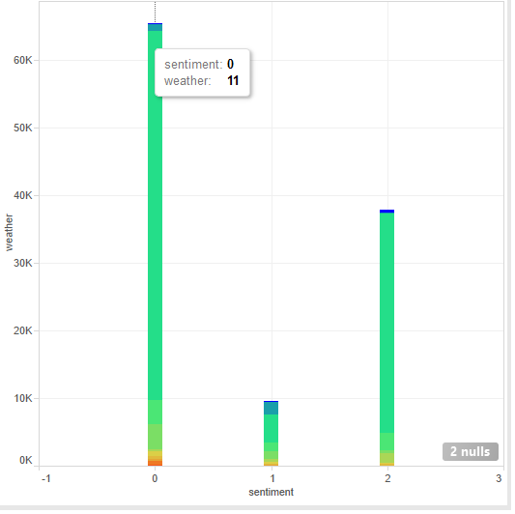
Sentimental Analysis contd..
For the Sandy , sentiment 0 (negative) and weather 11(storms) has more no of tweets.

Slide 18
Limitations
Privacy settings
Live analysis
Not applicable to all domains because of less train data
Implemented for only one language(English)
Analysis on emoticons

Slide 19
Future Work…
Analyze the sentiments based on emoticons
Would try to implement analysis on live data uploading at twitter server
Collecting data set on different languages

